Slide 1


Smart Systems for Occupancy and Building Energy Control
SSOBEC Version 2
Team:
Irvin Steve Cardenas (Software Engineer / Software Tester)
Diana Leante Boné (Software Engineer / Software Tester) Mentor: Ali Mostafavi, Leonardo Bobadilla
Notes:
Good morning everyone my name is irvin Steve Cardenas and along with Diana Leante Bone we worked on the second version of the Smart Systems for Occupancy and Building Energy Control application (abbreviated SSOBEC).
The project was based of the research of Dr. Ali Mostafavi and Dr. Leonardo Bobadilla, both whom served as our mentors.

Slide 2
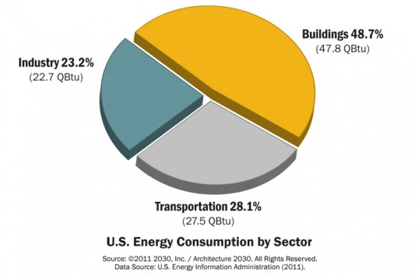
Problem Definition
Smart buildings, have a broader mission that involves providing energy efficiency (minimizing energy costs) and reducing environmental impact.
Users are key players
Positive or negative impact on the efficiency of a building.
Make users energy literate
Notes:
So when we look at energy consumption by sector we see that buildings are large consumers by energy.
Now what further research shows is that about 90% of the energy consumed by buildings come from heating, ventilation and air-conditioning systems. Lighting fixtures and plug loads (meaning.
So the question is how can we approach this problem. And the current solution is to create smart buildings that can monitor the efficiency of a building, even to the point of providing user with Building Management Systems (BMS). Now, a major draw back of these system is the they are usually vendor dependent.
And also mainly focus on providing reports about energy consumption or allowing a single user to monitor a building.
BUT there has yet to a SYSTEM that focuses on interaction between a building and it occupants.
Aiming to make the OCCUPANTS ENERGY LITERATE.
And ladies and gentleman this is what SSOBEC aims to do.
It aims to increase social awareness of energy consumption by introducing the aspect of social gaming.
We are introducing the social aspect, more specifically the aspect of social gaming to educating user about energ consumption.

Slide 3
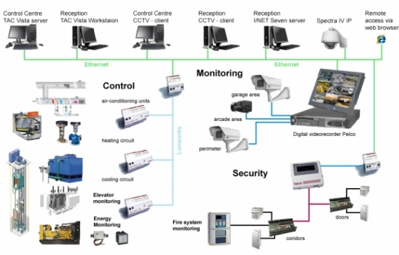
Vendor Systems
Building Manage System Architecture
Notes:
As I mentioned, there are current solutions that aim at monitoring a building’s efficiency.
These systems are called Building Management Systems.
And there are also independent hardware vendor that focus at making your home smart and give you control of lighting fixture and or energy plugs.

Slide 4
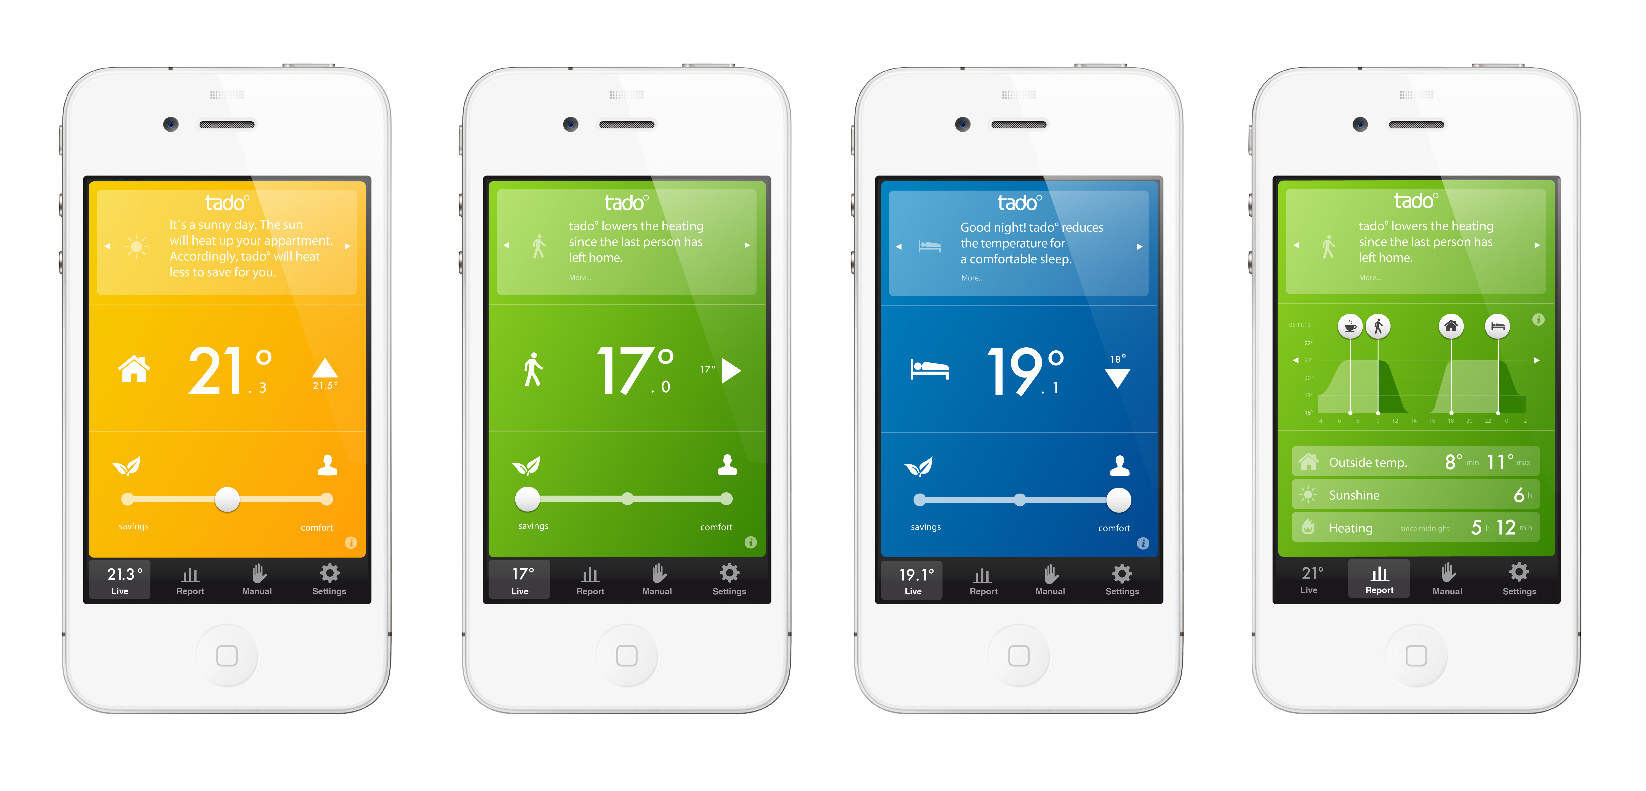
Vendor Systems
Smart Thermostat
Notes:
As I mentioned, there are current solutions that aim at monitoring a building’s efficiency.
These systems are called Building Management Systems.
And there are also independent hardware vendor that focus at making your home smart and give you control of lighting fixture and or energy plugs.

Slide 5
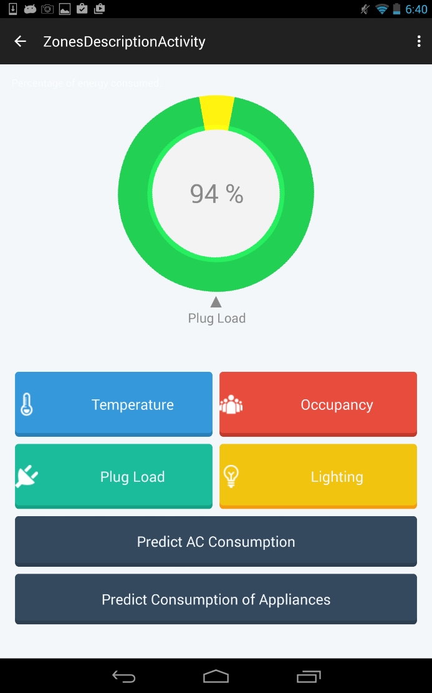
SSOBEC Previous System
Limitations
Limited User Roles
Limited User Functionality
Static interaction with building
No Interaction with lighting fixtures
No interactions with appliances
No knowledge extraction
No reports
Concept of social gaming and rewards was missing
SSOBEC Version 1
Notes:
Now the SSOBEC is based off previous versioned developed by our peers:
Dalaidis Hidalgo
And
Maria E. Presa Reyes

Slide 6
Requirements – User Stories
Allow Facility Manager to add Users to existing Zone
Allow Facility Manager to create a Zone
Allow Facility Manager to remove Users from existing Zone
Create Facility Manager View
Create general user view
Allow User to unfollow a zone
View Wasteful Regions
View Account Reward Points
Allow Facility Manager to edit Zone

Slide 7
Requirements – User Stories
Allow User to add appliances to Zone
Turn off Light in Wasteful Region and earn points
Turn off Appliance in Wasteful Region and earn points
Generate User statistics reports
Generate Zone statistics reports
Allow users to earn points by sending notifications
Notify users of wasteful regions
Provide user rankings
Provide personalized feedback suggestions for users
Create User Manual
Refine Final Document

Slide 8
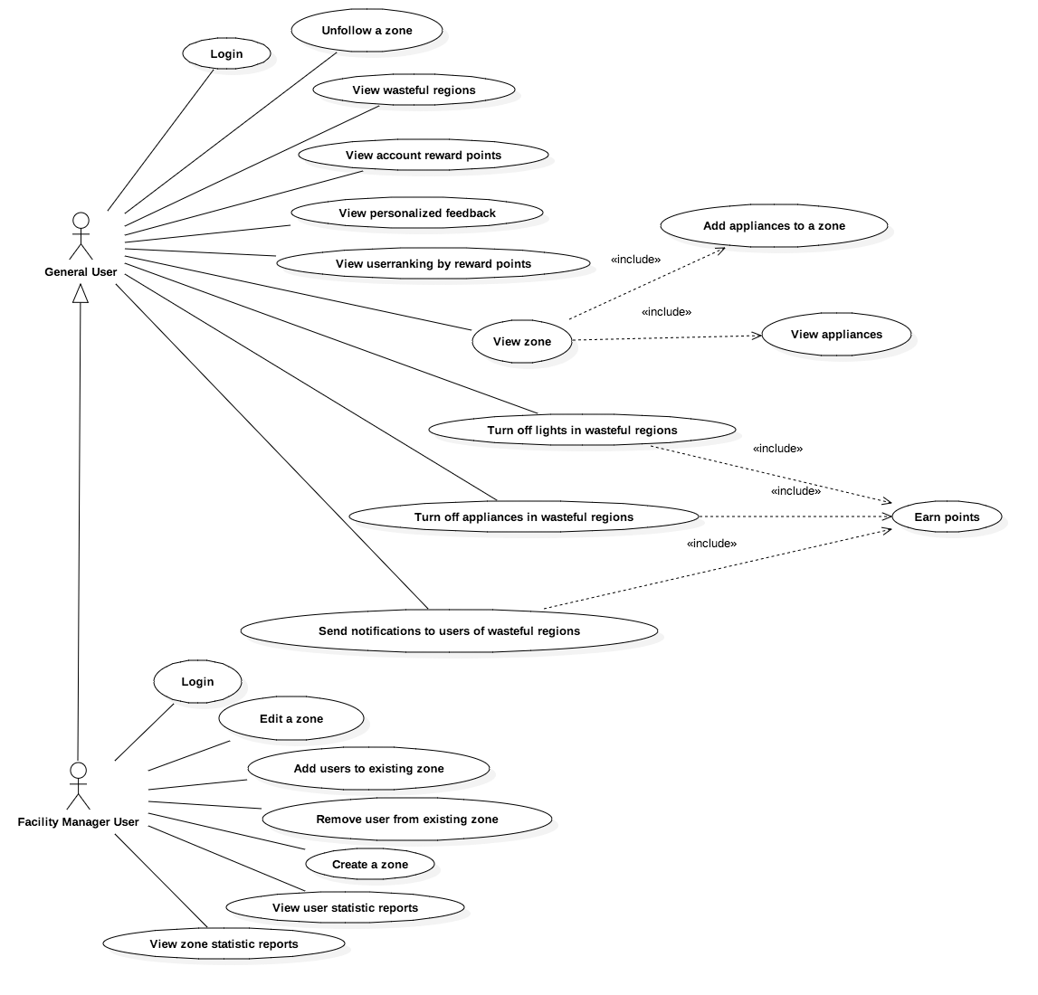
Use Cases

Slide 9
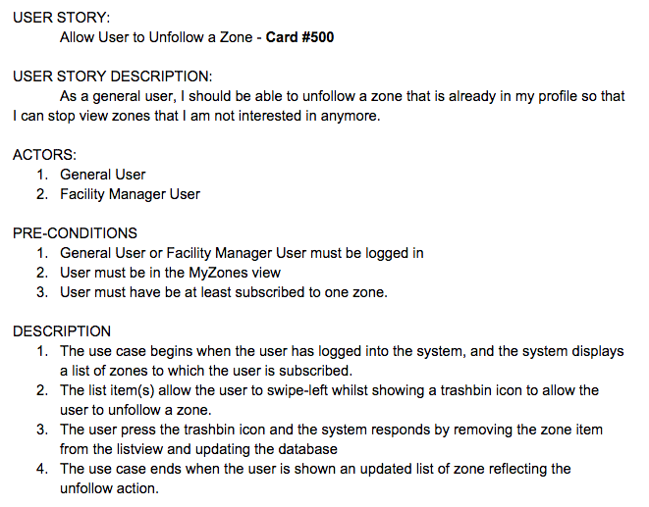
Use Cases

Slide 10
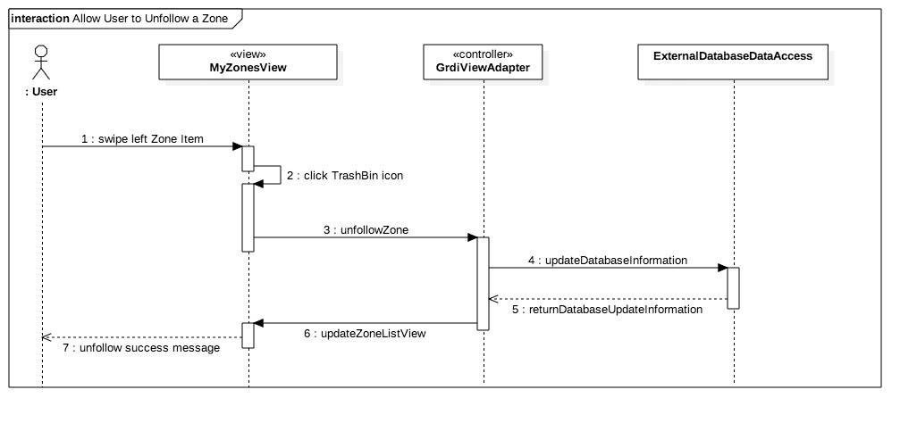
Sequence Diagrams

Slide 11
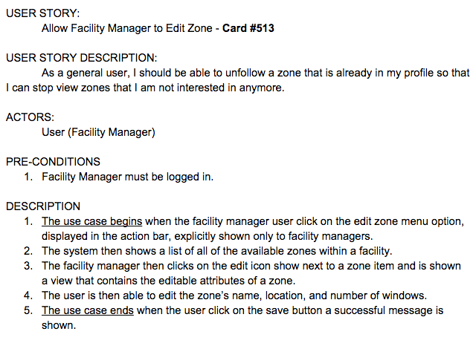
Use Cases

Slide 12
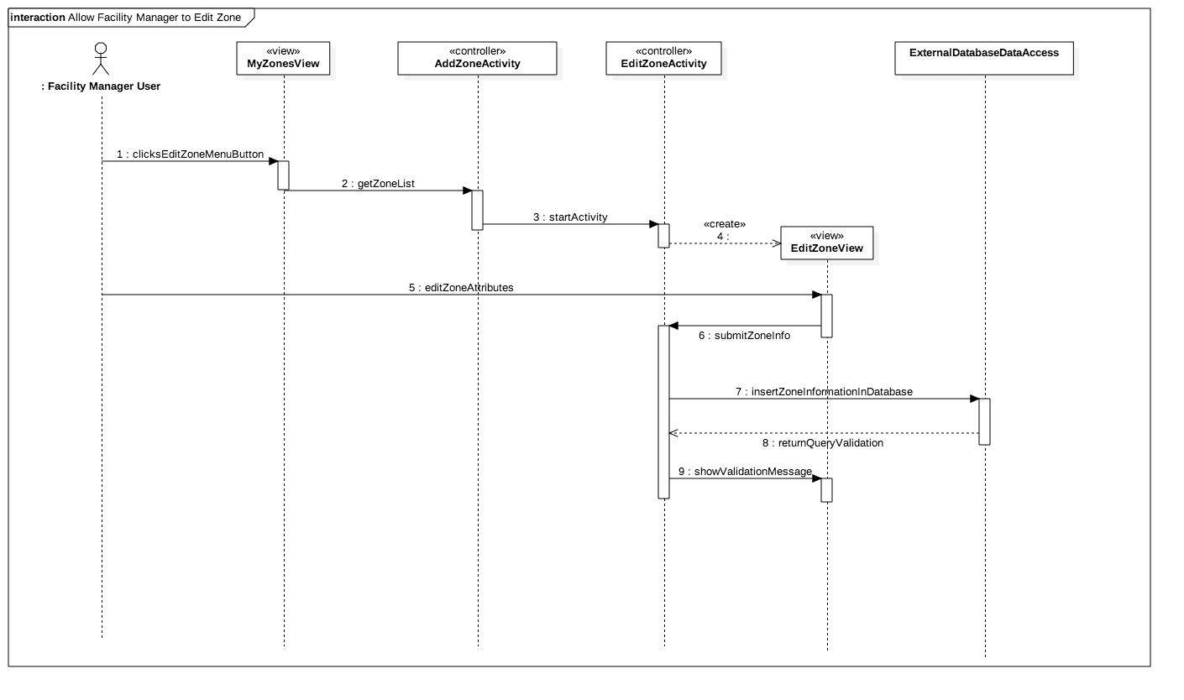
Sequence Diagrams

Slide 13
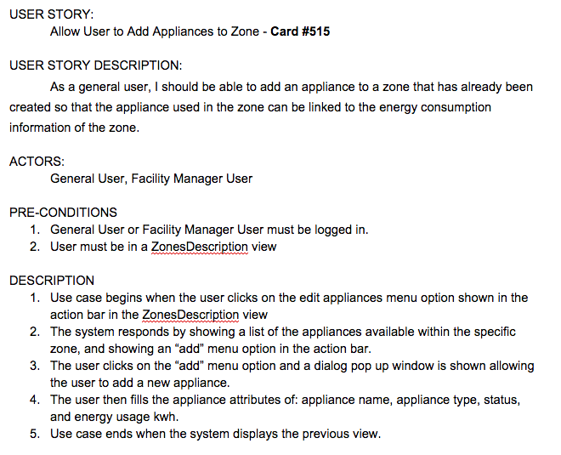
Use Cases

Slide 14
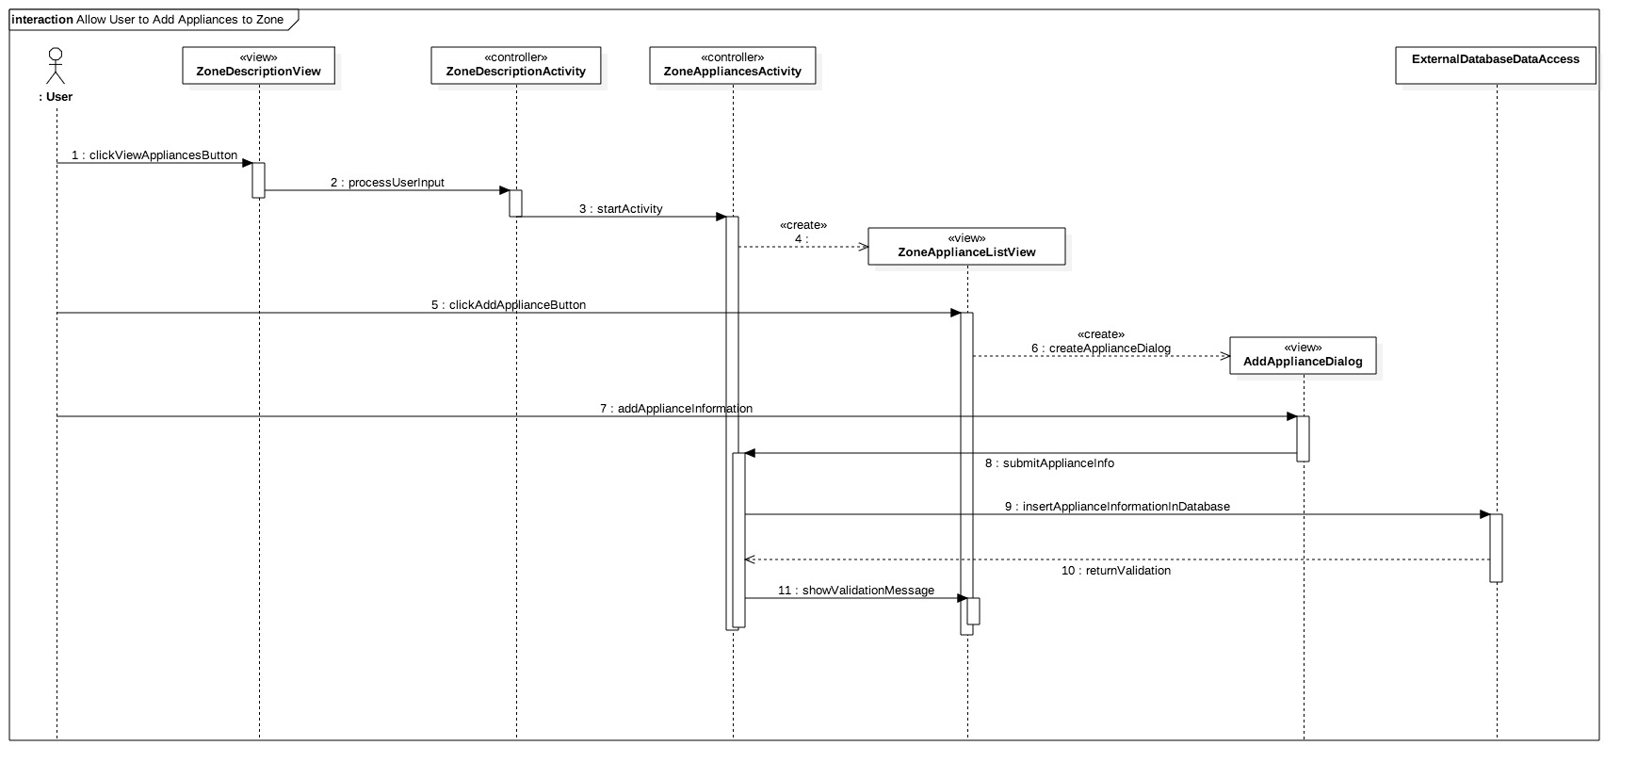
Sequence Diagrams

Slide 15
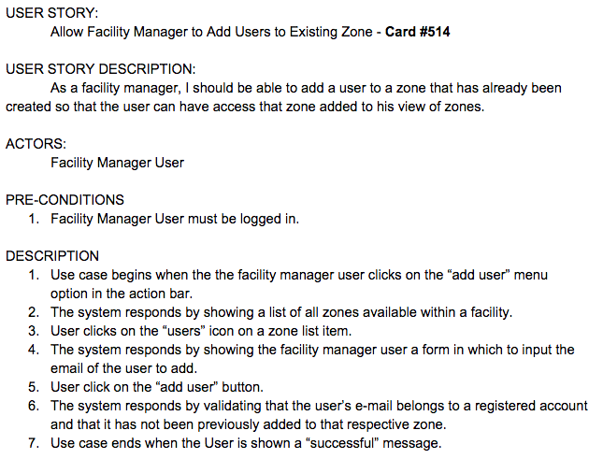
Use Cases

Slide 16
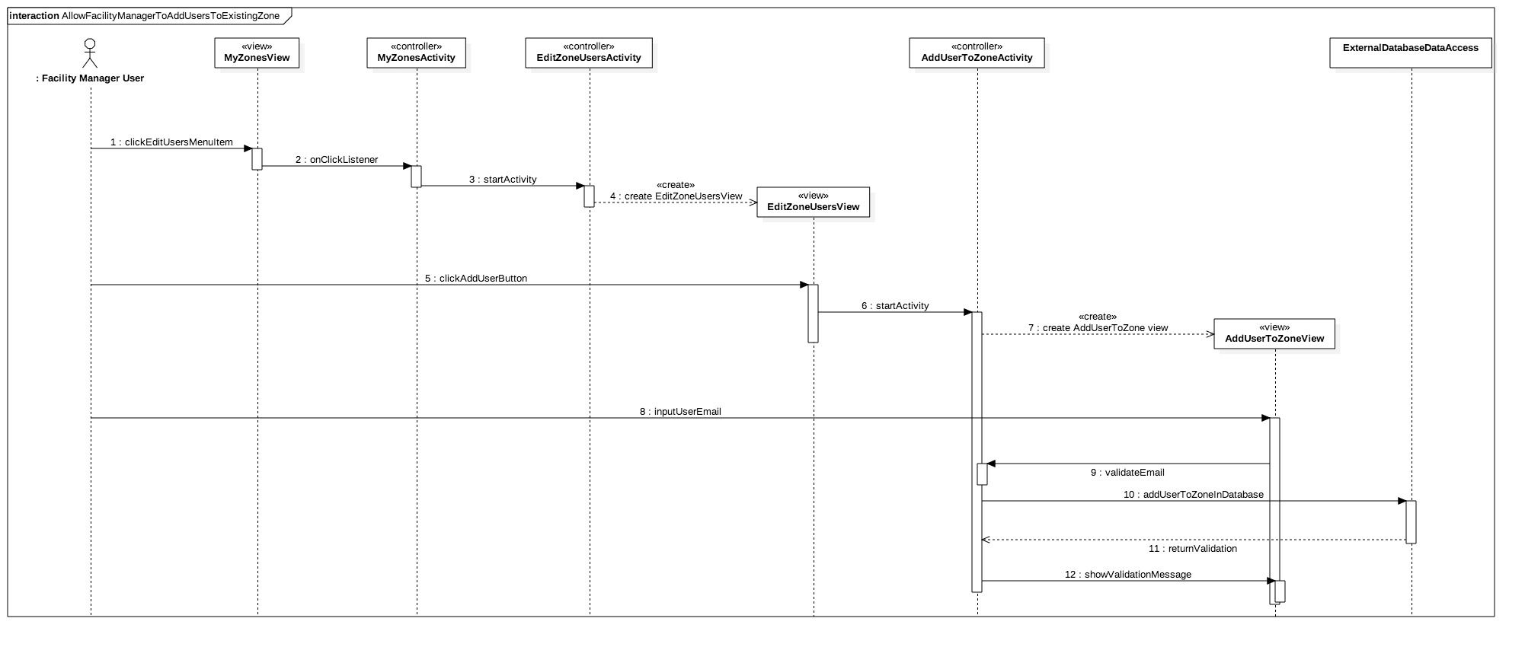
Sequence Diagrams

Slide 17
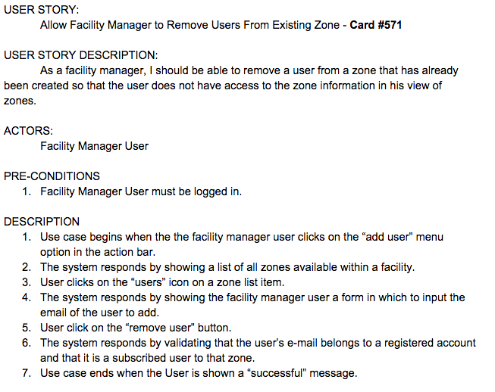
Use Cases

Slide 18
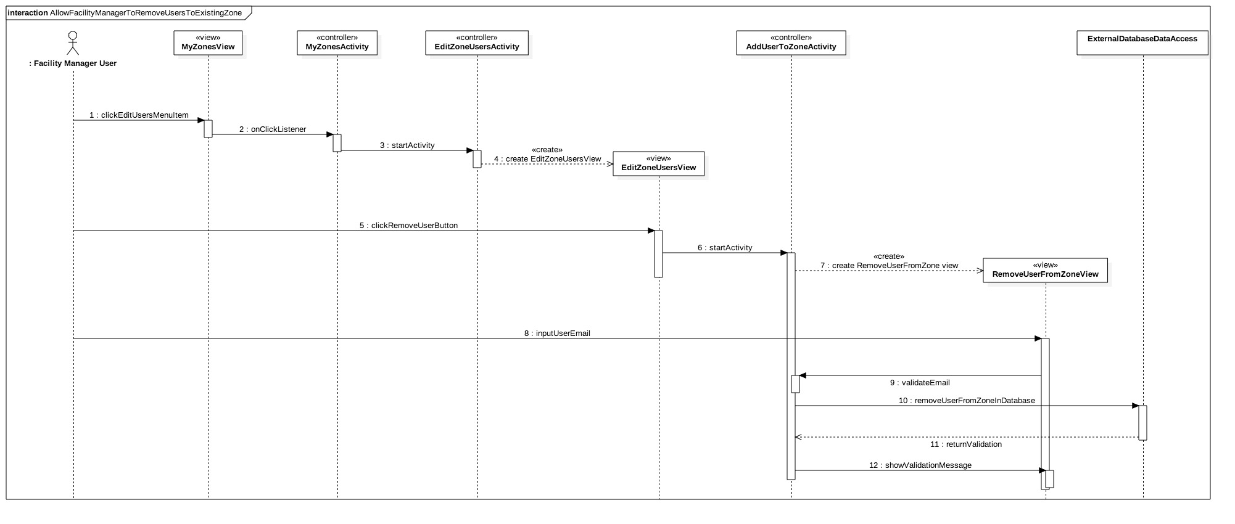
Sequence Diagrams

Slide 19
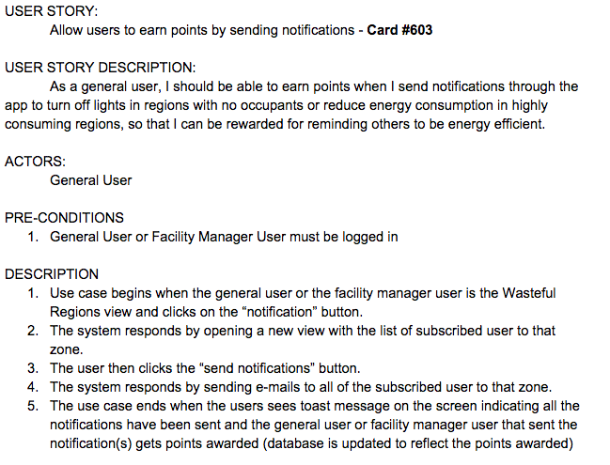
Use Cases

Slide 20
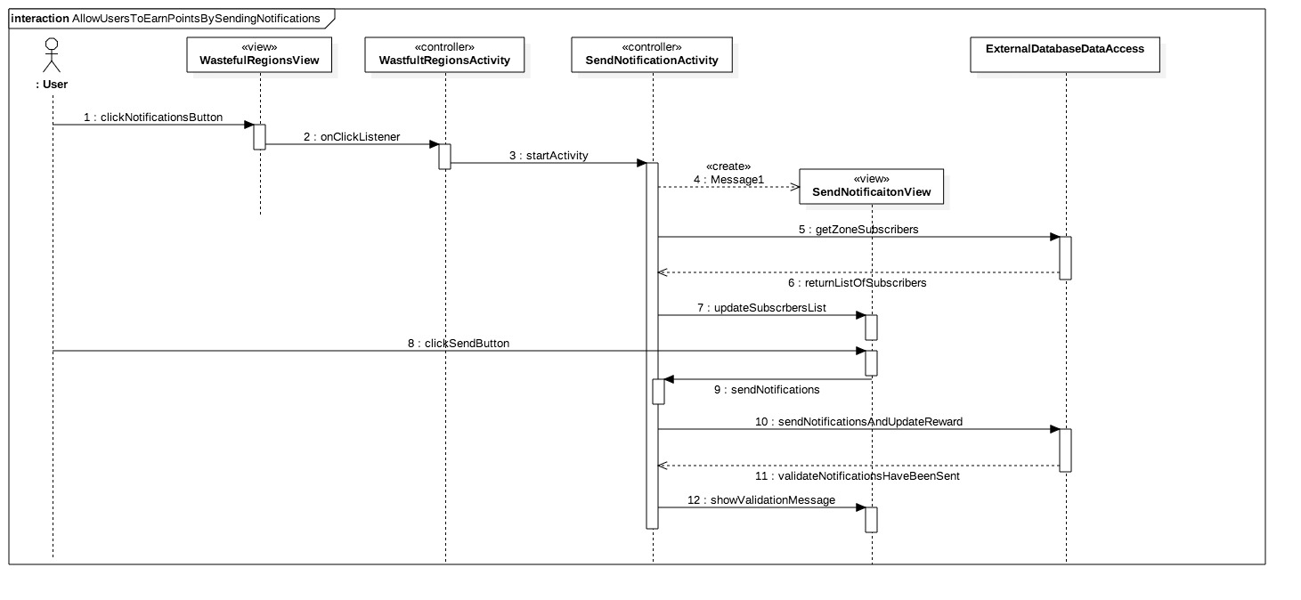
Sequence Diagrams

Slide 21
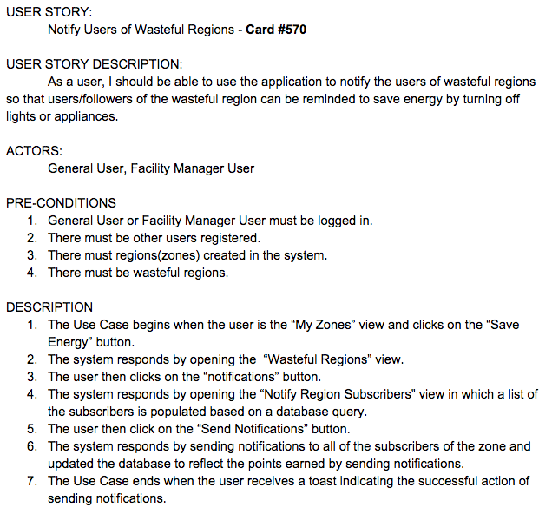
Use Cases

Slide 22
Sequence Diagrams

Slide 23
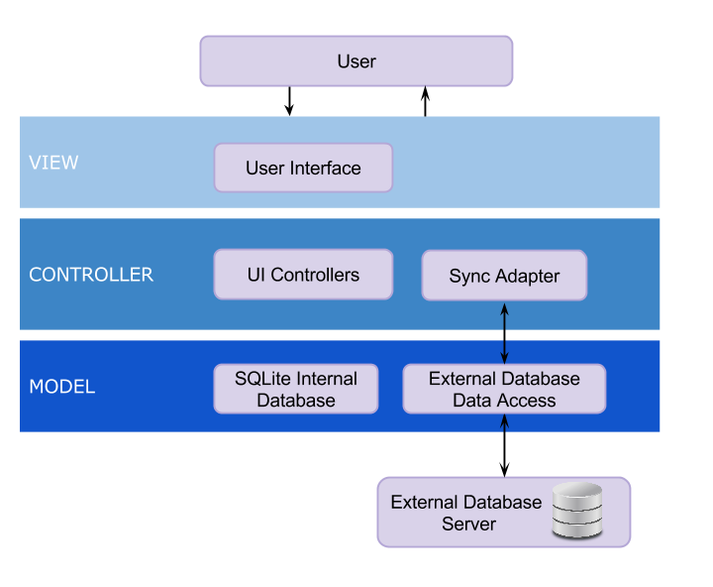
System Design - System Decomposition

Slide 24
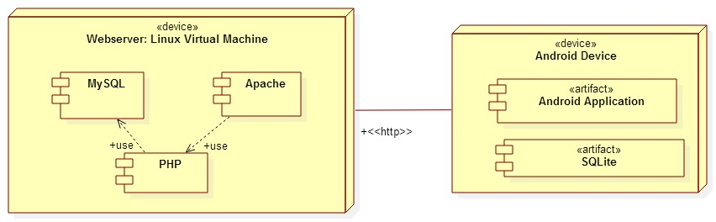
System Design - System Deployment

Slide 25
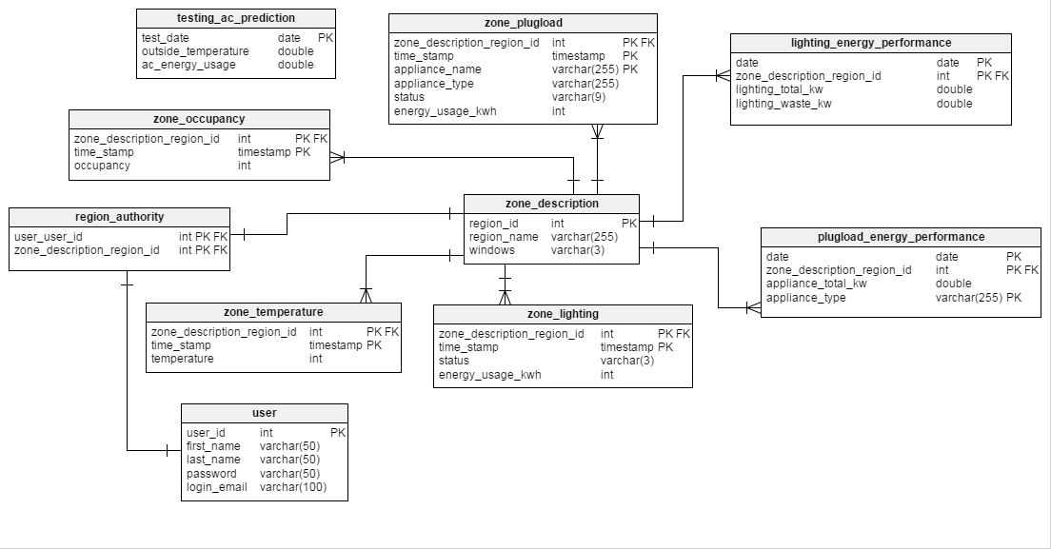
System Design - Persistent Data Design

Slide 26
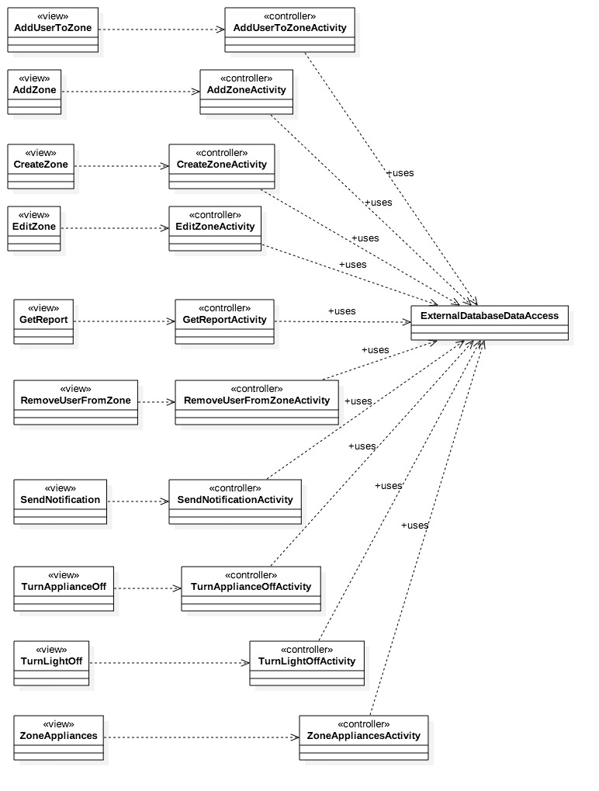
Minimal Class Diagram

Slide 27
State Machine
Stopped
Destroyed
onStop()
Paused
onResume()
onResume()
onPause()
Activity
Running
onCreate()
onResume()

Slide 28
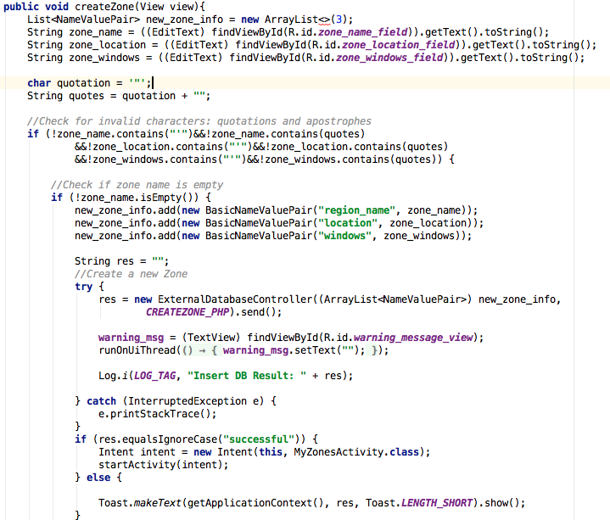
Algorithm for “Allow Facility Manager to Create a Zone”
Verify user is a Facility Manager
Validate zone attributes inserted by user
If zone attributes are invalid or empty reject attempt to create a zone
Else if zone attributes are valid attempt to insert into external database
Inform user if the database insertion was successful or not

Slide 29
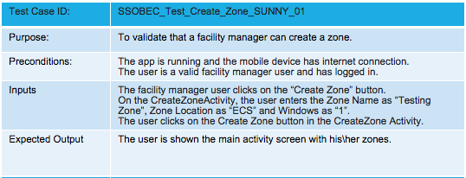
Validate That Facility Manager Can Create a Zone

Slide 30
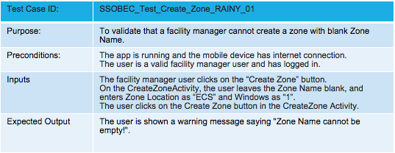
Validate That Facility Manager Can Create a Zone

